Slide 1

Memories Website
20104044 Siddhesh Vijay Sawan
20104137 Hitesh Vasudev Sachdev
20104050 Aman lalchand Yadav
Project Guide
Ms. Manjusha Kashilkar

Slide 2
Contents
Introduction
Objectives
Scope
Literature Survey
Proposed System
Project Outcomes
Block Diagram
Use Case/DFD
Technology Stack
Suggestions in Review-1
Result and Discussion
Conclusion and Future Scope
References

Slide 3
1. Introduction
Life passes by quickly, So saving special moments on social media is a fun way to remember events and share with others. So we're working on Memories Application which allows users to post interesting events in their life and revisit those memories.
Memories make us who we are. They create our worldview in ways we hardly realize. Like a character made of Legos, we're built of blocks of memory that all fit together to form our consciousness.
Someone has said that ‘Each happiness of yesterday is a memory for tomorrow.’

Slide 4
Problem Statement
Problem Identified :
One click searching of post based on different topics is not available on other websites.
Solution Proposed :
Our website provide one click searching of post based on different topics.
Click on the topic and see post caption with that topic name.

Slide 5
2. Objectives
To build user friendly website.
To add memories like places they are visited or things they have enjoyed.
To add videos of memories with title.
Other users can like and comment on videos.
User can also see the video they’ve posted or liked on their profile.
User can search memories posted on website.

Slide 6
3. Scope
It can be useful to those who wish to showcase and share their important memories in life a place for Social media enthusiast.
Can be useful for Creating and store memory with title and other information.

Slide 7
Literature Survey
The Swedish social networking website LunarStorm, originally
called Stajlplejs, is launched in 1996. The site, founded by Rickard
Eriksson, was renamed LunarStorm in 2000 and has been
described as "The world's first social media on the Internet".
App similar to your website is
FACEBOOK:
YOUTUBE:
TikTok:

Slide 8
4. Feature /Functionality
1. Pagination Feature : Which allows you to only fetch a certain no. of memories at a time .
2. Search and Filtering : We can search tag like places or can search title and can get all the matching Memories.
3. Comments Feature : You can Comment on Users post.
4. Memories Detailed Page : You can click on any memories to see more Detailed information about it .

Slide 9
5. Outcome of Project
1.User can login and create Post with Title.
2. User can Post the memories.
3. User can Allow other user's to like that post.
4. User can Comment on that post

Slide 10
6. Technology Stack
Write what you have planned to develop front end ( GUI ) & Backend (Database if applicable)
1)ReactJs
2)HTML , CSS , JavaScript
3)Visual Studio
4)NextJs
5)Sanity
6)Google Identity Service API

Slide 11
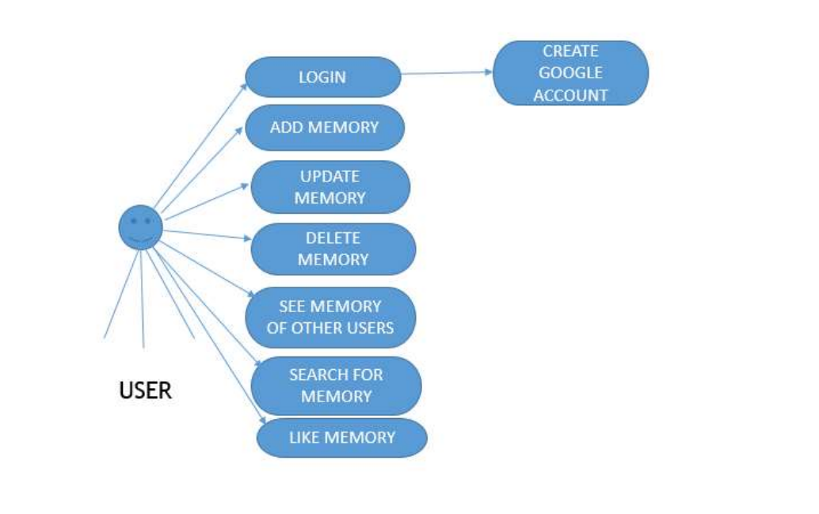
Use Case Diagram

Slide 12
7. Block Diagram
Home Web Page
Login Page
Signup Page
Memories Wall
Create and upload Memories

Slide 13
Suggestions in Review-1
We can search tag like places or can search title and can get all the matching Memories.
Comments Feature : You can Comment on Users post.

Slide 14
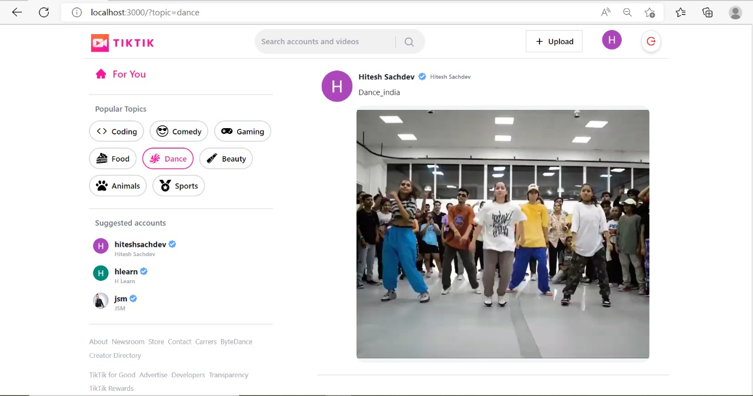
Result and Discussion

Slide 15
Conclusion and Future Scope
1)Have setup the website where user can share their precious
memories and revisit whenever they want
2)In future usere will able to make their profile public and private and also
get option to follow othere user profile

Slide 16
References
1)We take reference of youtube https://youtu.be/CcBHZ0t2Qwc
2)For database we take reference of the https://www.sanity.io/guides/hello-world

Slide 17
Thank You...!!

